Slide 1
A TRUSTED BLOCKCHAIN-BASED TRACEABILITY SYSTEM FOR FRUIT AND VEGETABLE AGRICULTURAL PRODUCTS
GUIDED BY: Prof. S. Gladson Oliver
TEAM MEMBERS
DHARSHINI B - 1918109
INDHIRANI S - 1918112
JAYAMEENAKSHI S - 1918115
JAYAPRIYA G - 1918116
VARSHINI S - 1918143

Slide 2
PROBLEM STATEMENT
In recent years, food safety issues have drawn growing concerns from society.
In order to efficiently trace the accountability, building a reliable traceability system is indispensable.
It is especially essential to accurately record, share and trace the specific data within the whole food supply chain including the process of production, distribution, warehousing and until it finally reaches the customer.

Slide 3
EXISTING SYSTEM
Traditional traceability technology is mainly through two-dimensional code or barcode technology, combined with radio frequency identification (RFID) technology.
Through manual recording and storage in a centralized database,consumers can trace only the basic information of the product by scanning the barcode on the product package.
However, the process of grain food from farmland to dining table mainly includes the following links: production, distribution, warehousing and customer.

Slide 4
Contd..
Data in traditional traceability systems is centralized, and authoritative agencies manage the central database of the traceability system.
Since the traceability data of each supply chain node are managed by enterprise, the data are easy to tamper with.
Therefore, the reliability of information transmission among different roles in the agricultural supply chain needs to be increased.

Slide 5
DISADVANTAGES
Centralized management
Opaque information
Untrustworthy data

Slide 6
PROPOSED SYSTEM
Blockchain as an emerging technology that has properties of decentralization, tamper-proof and traceability provides the possibility to solve the problems existing in the current traditional agricultural product traceability system.
A traceability system based on blockchain technology for storage and query of product information in supply chain of agricultural products.
Leveraging the characteristics of decentralization, tamper-proof and traceability of blockchain technology, the transparency and credibility of traceability information increased.

Slide 7
ADVANTAGES
Decentralized
Security
Immutable transactions
Reliability

Slide 8
LITERATURE SURVEY
SI .NO | JOURNAL NAME | TITLE & YEAR | AUTHOR(S) | ABOUT | ADVANTAGES | DISADVANTAGES
1 | IEEE | Secure Identification, Traceability and Real-Time Tracking of Agricultural Food Supply During Transportation Using Internet of Things 2021 | MUHAMMAD NASIR MUMTAZ BHUTTA AND MUNEER AHMAD | It proposes an IoT based system for secure identification, traceability, and real-time tracking of agricultural food products during transportation. The system provides an end-to-end solution for monitoring the food supply chain, improving food safety, and reducing waste | The system helps food businesses comply with regulatory requirements related to food safety and traceability, reducing the risk of fines and legal liabilities | High Implementation Costs, Data Privacy and Security Risks, Dependence on Technology, Complex Integration

Slide 9
SI .NO | JOURNAL NAME | TITLE & YEAR | AUTHOR(S) | ABOUT | ADVANTAGES | DISADVANTAGES
2 | IEEE | Smart Contract-Based Product Traceability System in the Supply Chain Scenario 2019 | SHANGPING WANG, DONGYI LI | A product traceability system based on blockchain technology, in which all product transferring histories are perpetually recorded in a distributed ledger by using smart contracts and a chain is formed that can trace back to the source of the products. | It has obvious decentralized characteristics, which significantly reduces the possibility of privately tampering with data within enterprises. | Possibility of manual input errors
3 | IEEE | Construct Food Safety Traceability System for People’s Health Under the Internet of Things and Big Data 2021 | PRATYUSH KUMAR PATRO ,RAJA JAYARAMAN , | Building a food safety traceability system utilizing the Internet of Things and Big Data is crucial for ensuring people's health. This paper proposes a framework for constructing such a system, highlighting the significance of data integration and the utilization of emerging technologies | The system can improve supply chain management, reduce waste, and enhance the reputation of food businesses, ultimately leading to increased profitability. | Dependence on Technology, Need for Industry-wide Adoption, Complexity

Slide 10
SI .NO | JOURNAL NAME | TITLE & YEAR | AUTHOR(S) | ABOUT | ADVANTAGES | DISADVANTAGES
4 | IEEE | Use of RFID Based Real Time Location Tracking System to Curb Diversion of Transit Goods in East Africa 2009 | Joseph K. Siror, Sheng Huanye, Wang Dong, Wu Ji | It is designed to address the problem of diversions of transit wet cargo destined for hinterland countries into the local markets, so as to evade payment of duties and taxes using RFID | It enables speedy movement of cargo from the port to various destinations in the region | The real time information will not be available where there is no network coverage at the control room. Unscrupulous traders could siphon fuel through unofficial openings.
5 | IEEE | Traceability in Agri-Food Sector using RFID 2010 | Arun N. Nambiar | RFID is one such technology that facilitates automatic data collection.Due to the nature of the products, the capability of continuously monitor the products as they travels through the supply chain becomes indispensable. | RFID tags facilitate quick and easy data collection at multiple points in the supply chain.RFID systems can be good use in improving the accuracy of traceability system | Safe storage of data and its easy access becomes one issue. Another issues is ensuring the privacy of data being collected within the traceability system is difficult.

Slide 11
Tool used – Ganache UI
Ganache is a personal blockchain for Ethereum development. It allows developers to test their smart contracts and applications in a local and isolated environment before deploying them to the main Ethereum network. It allows for rapid development and testing.
Ganache also provides a user-friendly interface that allows developers to interact with their local blockchain using a graphical user interface (GUI). This interface allows you to see the status of your blockchain, view transaction details, and monitor network activity.

Slide 12
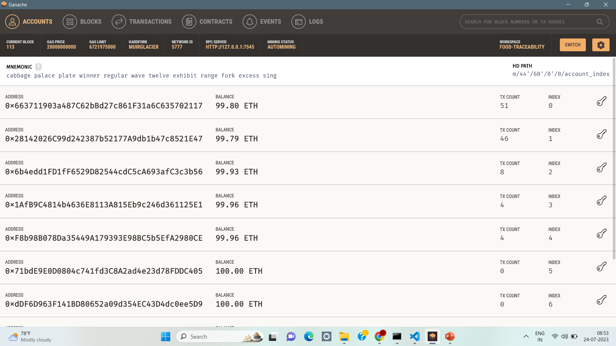

Slide 13
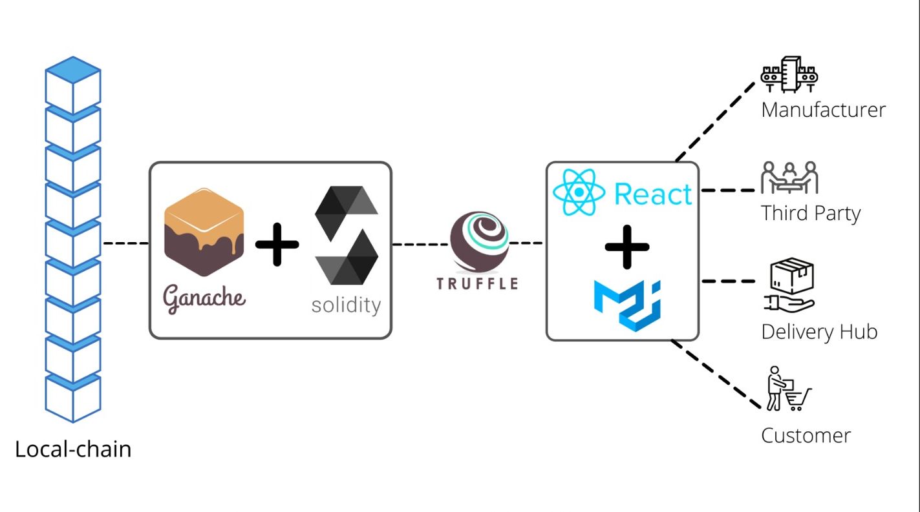
ARCHITECTURE DIAGRAM

Slide 14
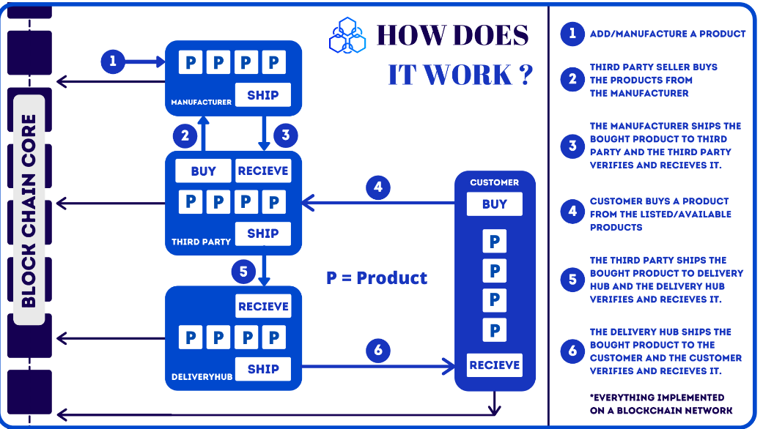
WORKING
RECEIVE
RECEIVE
RECEIVE

Slide 15
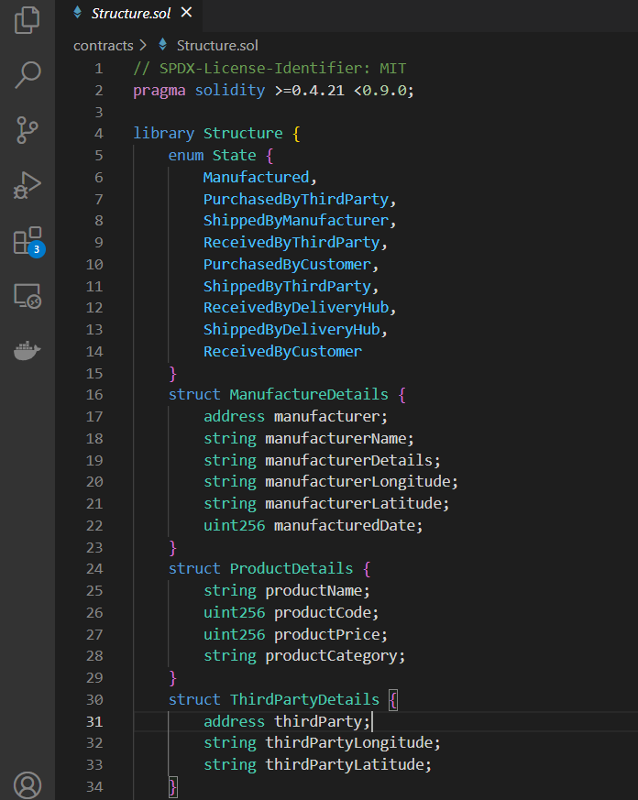
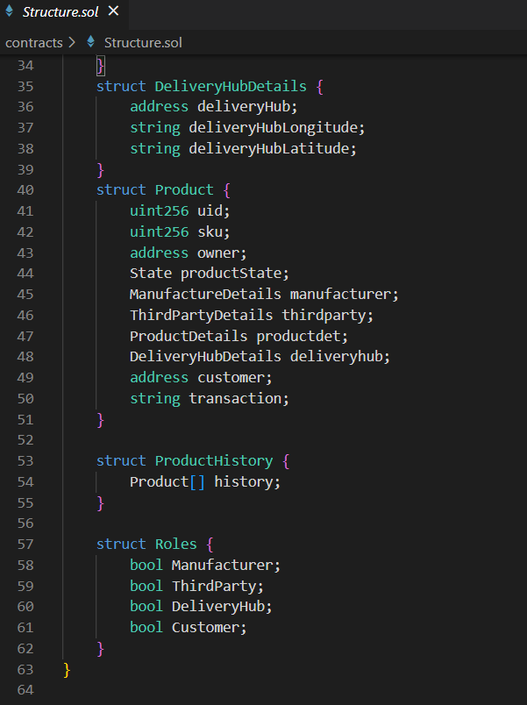
STRUCTURE.SOL

Slide 16
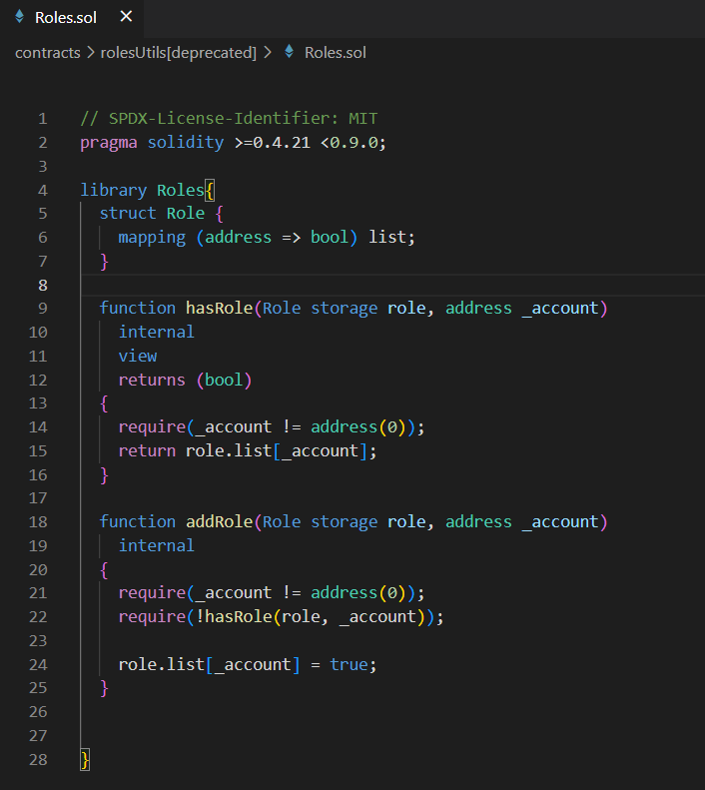
ROLES.SOL

Slide 17
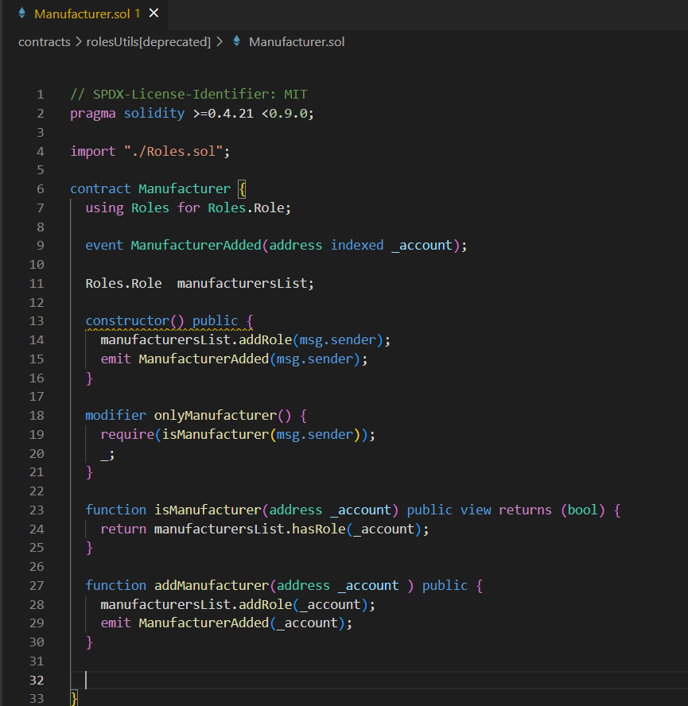
MANUFACTURER.SOL

Slide 18
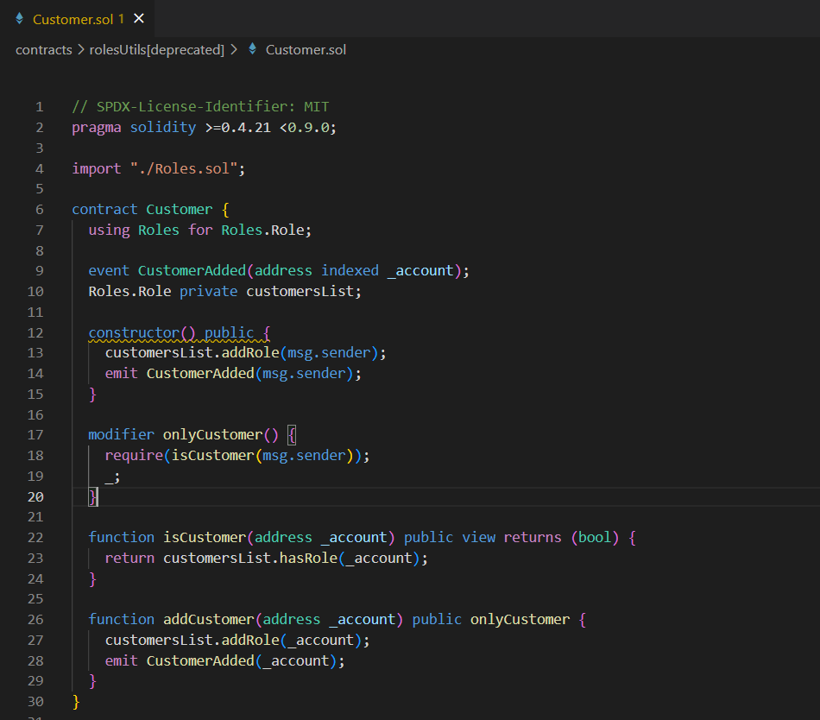
CUSTOMER.SOL

Slide 19
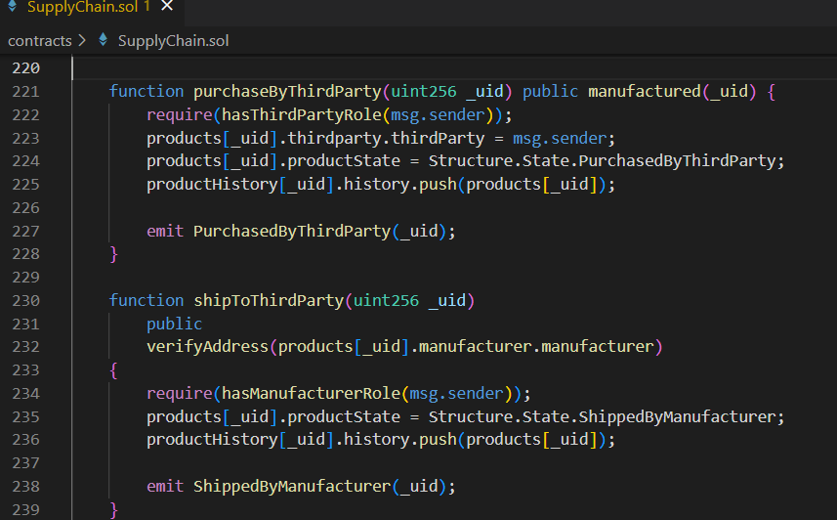
SUPPLYCHAIN.SOL

Slide 20
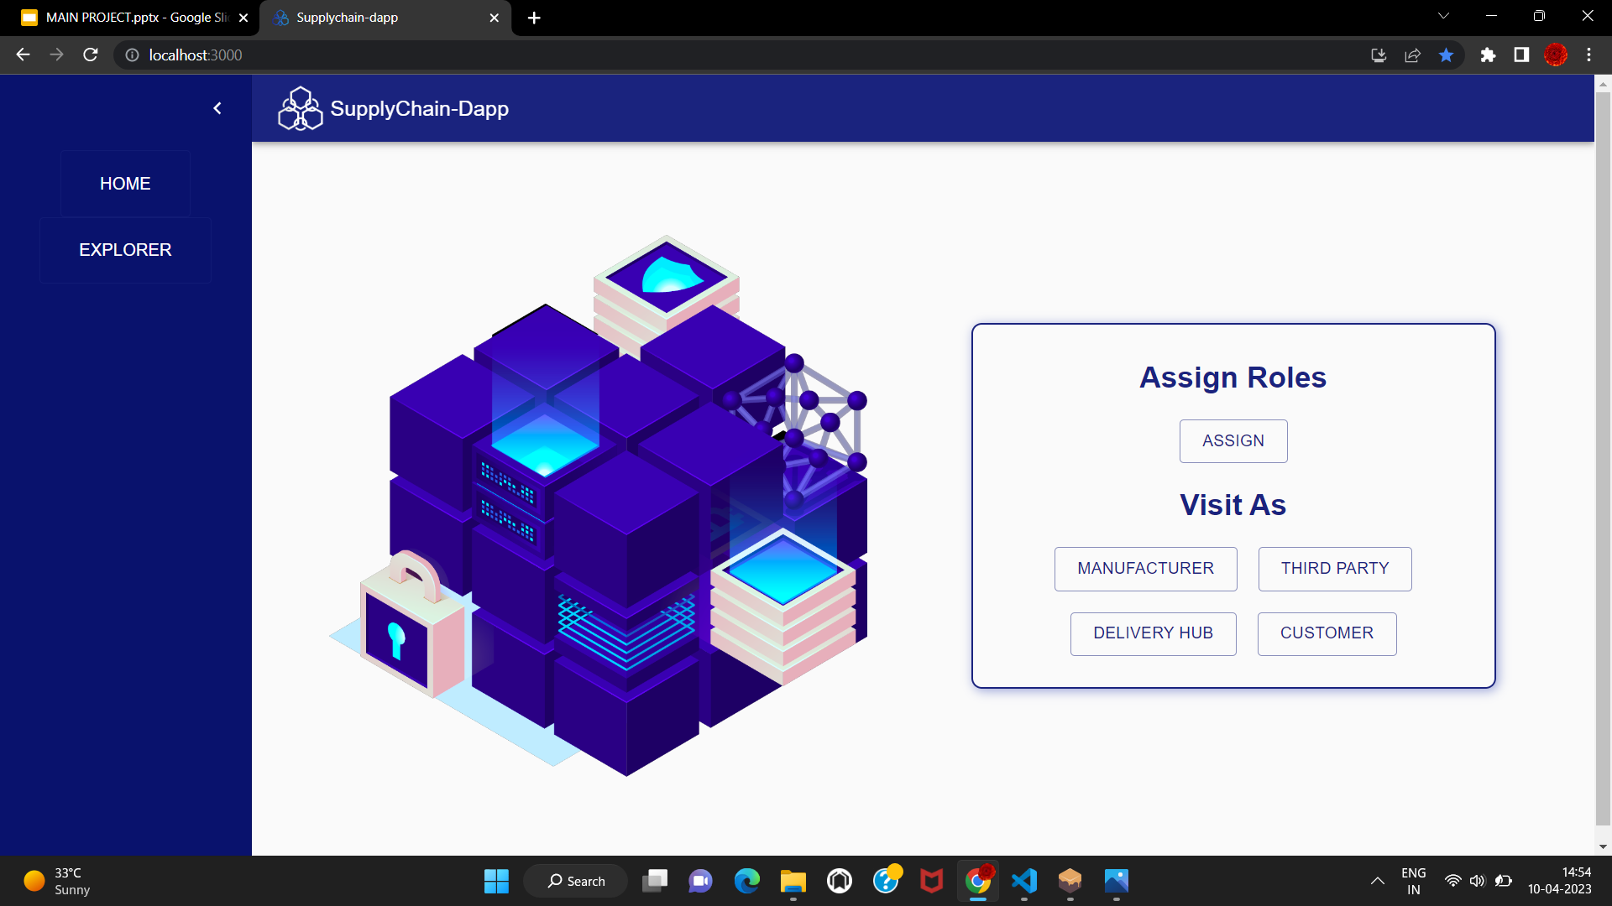

Slide 21
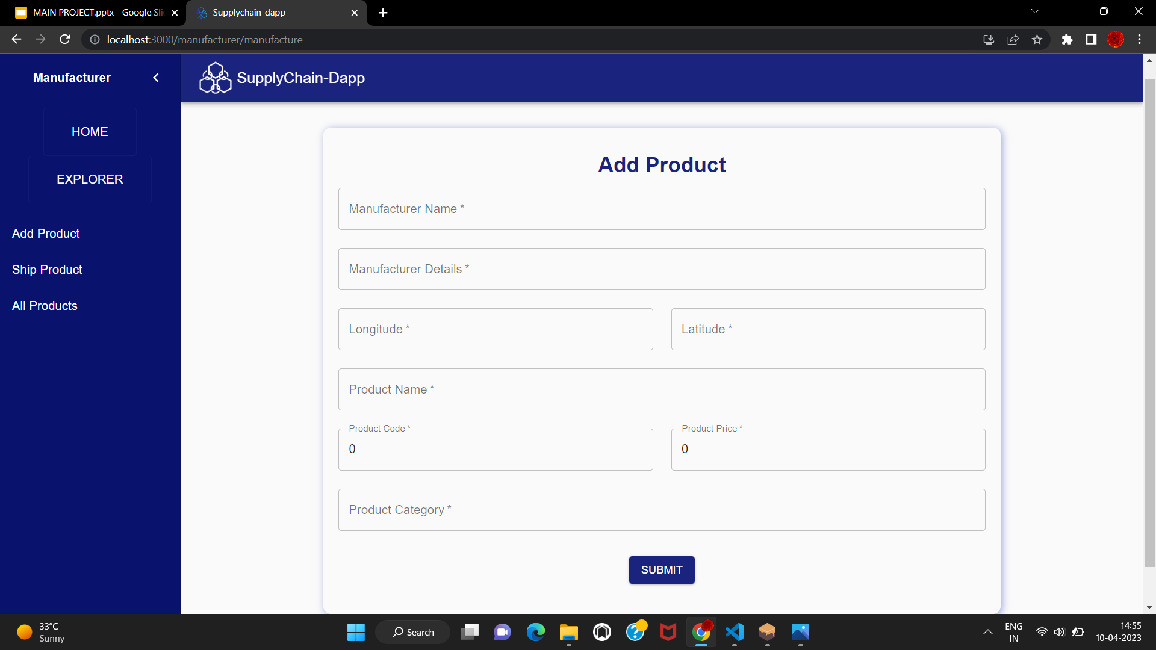

Slide 22
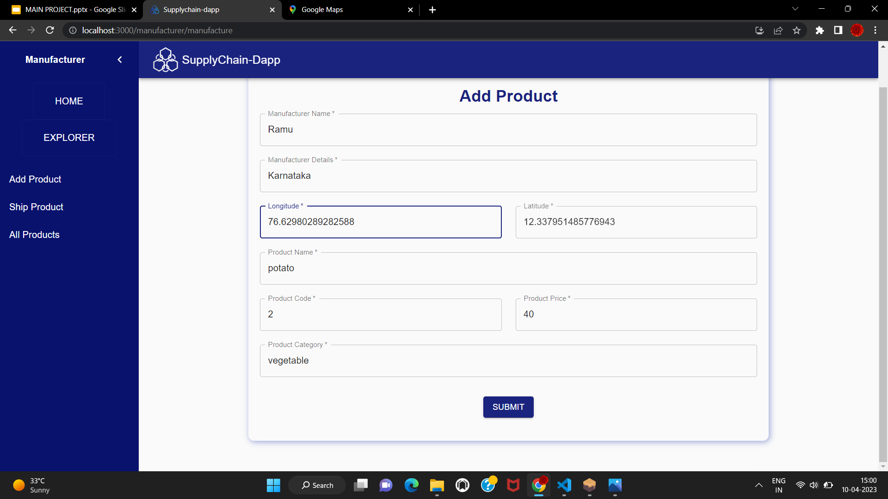

Slide 23
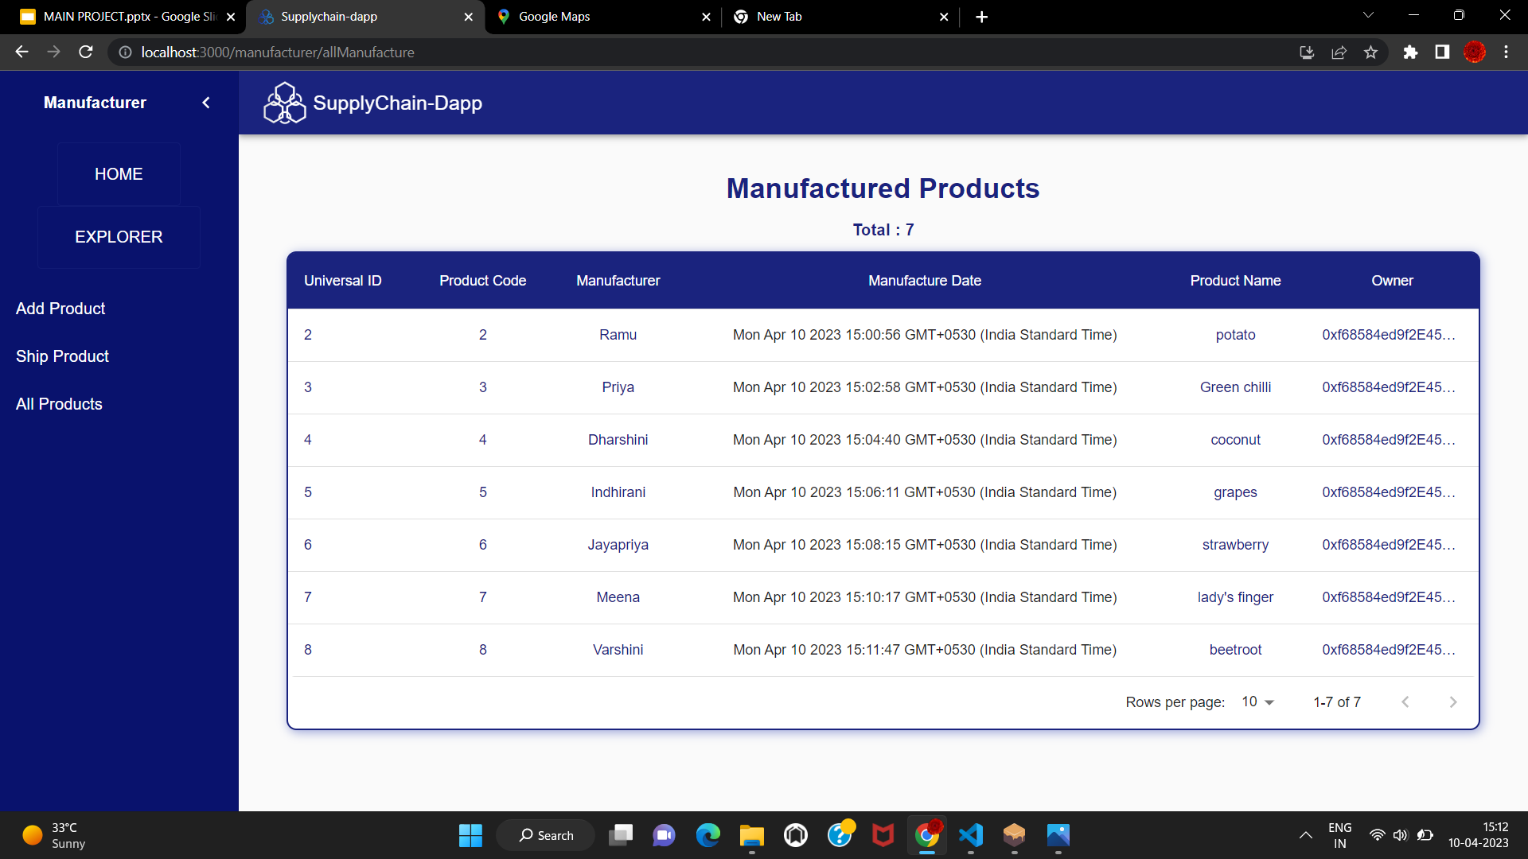

Slide 24
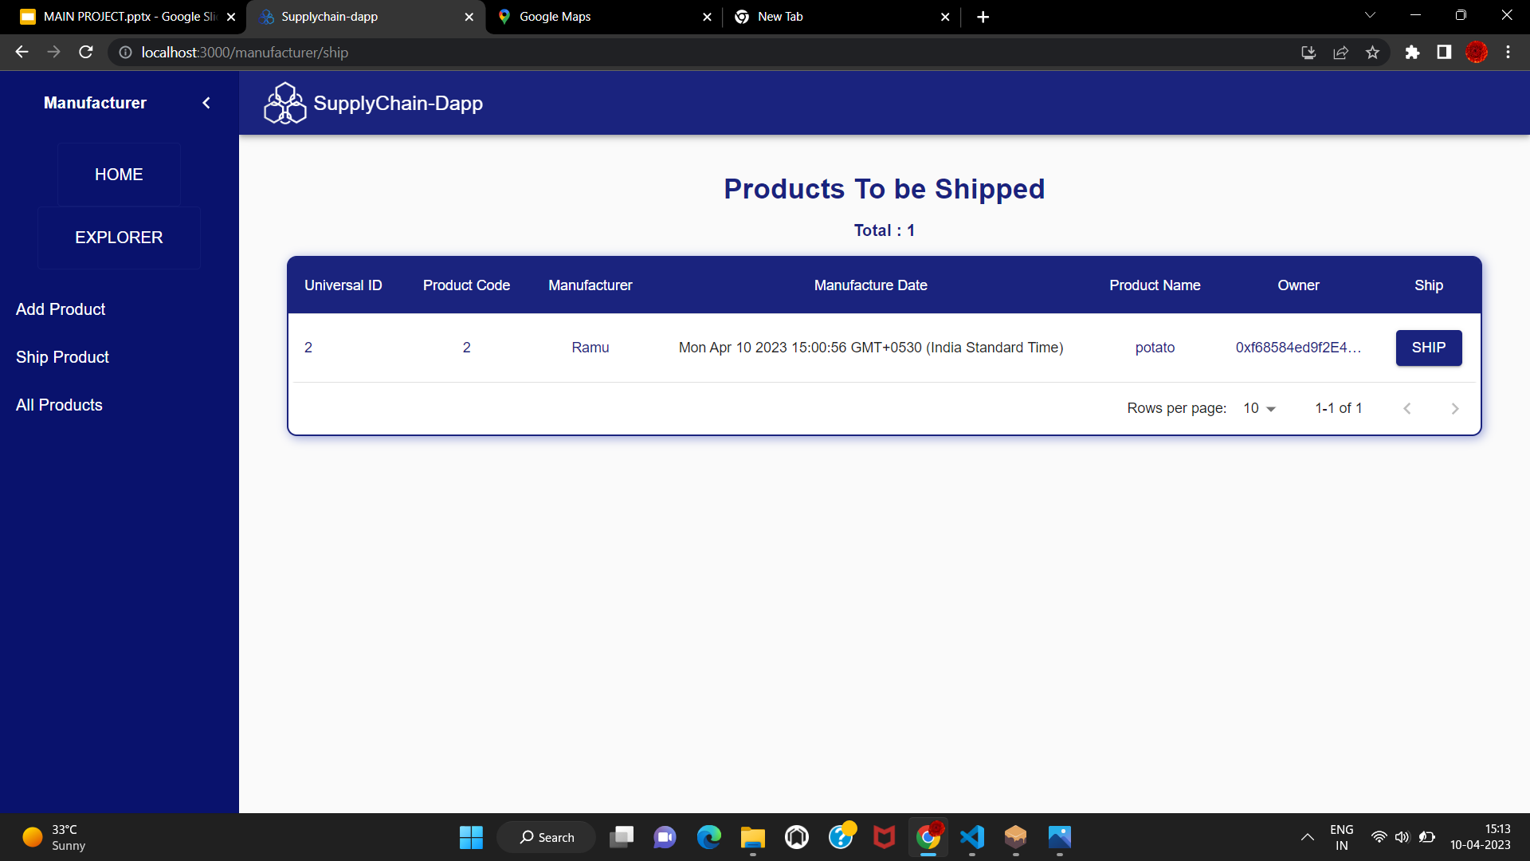

Slide 25
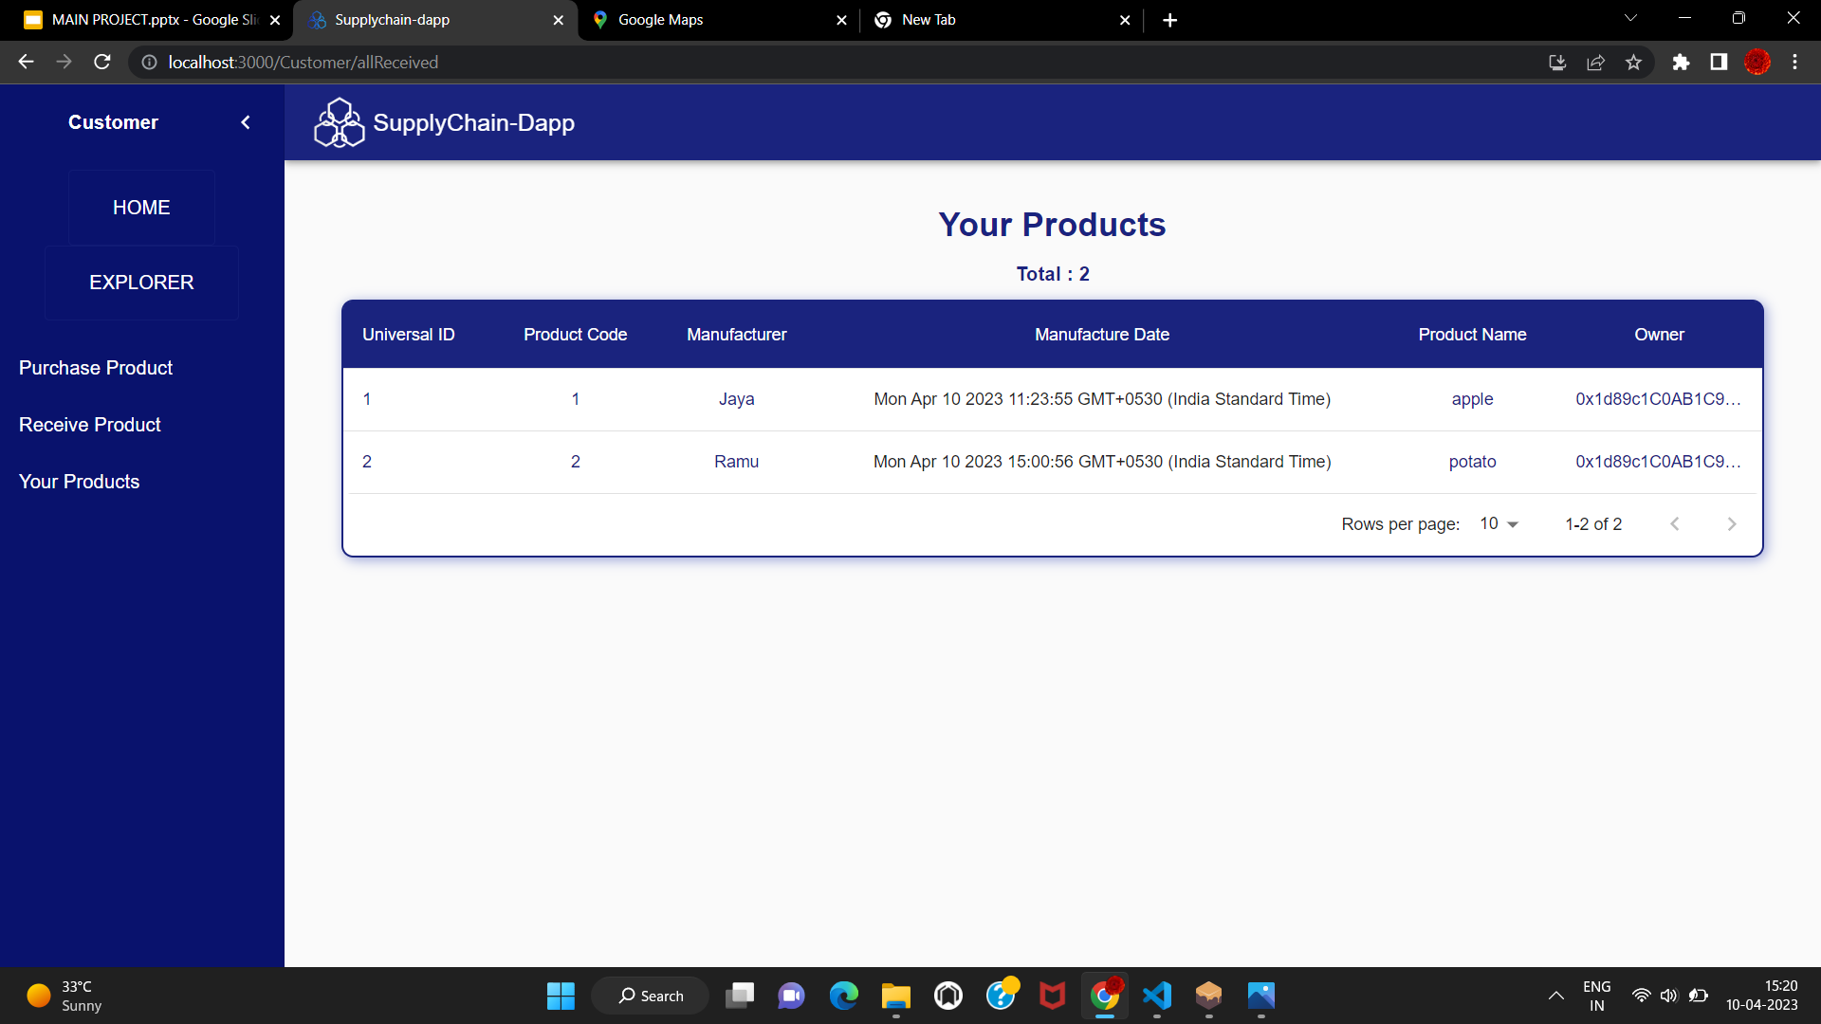

Slide 26
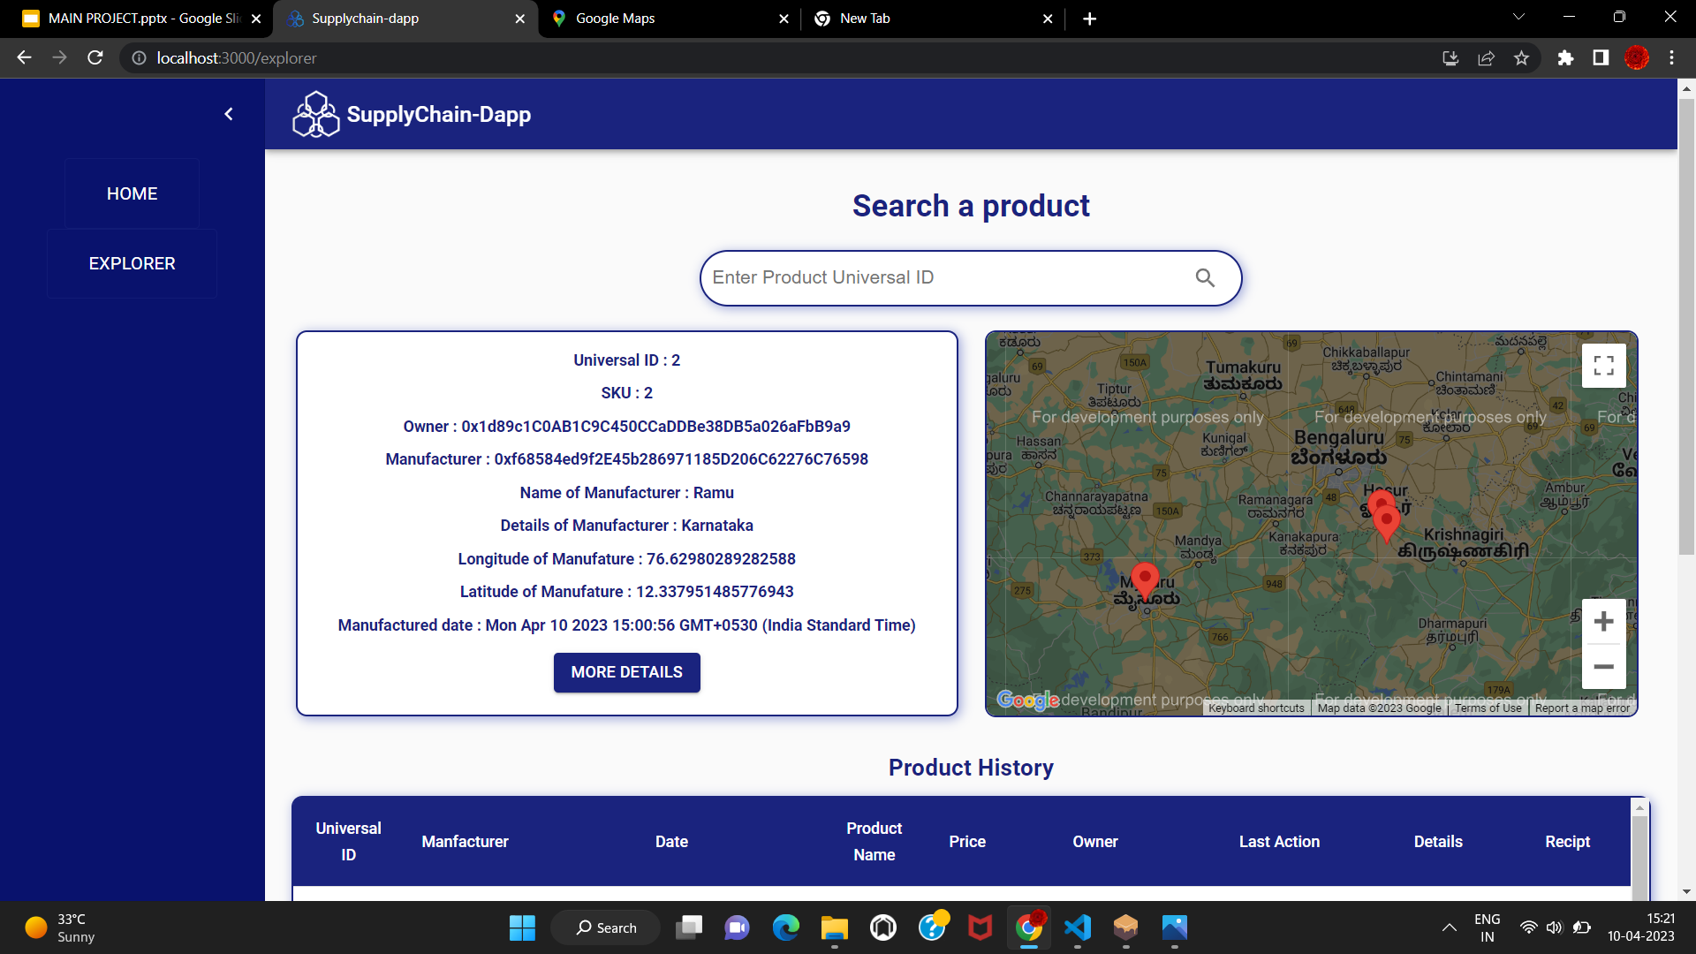

Slide 27
